Slide 1

NEWS SENTIMENT ANALYSIS
2
+
2
+
Data Science Programming
Presented by:
Motahareh (Bahar) Pourbehzadi
Teammates: Andrei Pomorov, Sandeep Kumar, Devesh Tomar, Sivaramakrishna Allam

Slide 2

What is our motive?
2
+
Facebook Outage
on Oct 4^{th,} 2021 the Facebook company experienced a major outage that affected the users of Facebook, WhatsApp and Instagram. We are interested to see whether there is a meaningful correlation between the Facebook stock price and the sentiments of the news before and after this incident.

Slide 3
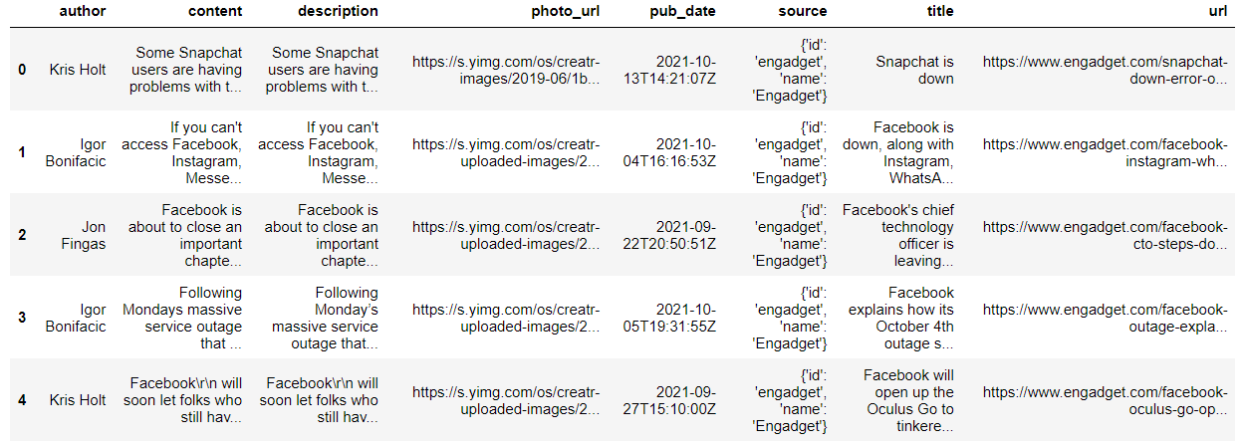
News segment (data)
Data Collection
Data resources and challenges
Data Cleaning a pre-processing:
Tokenization
Removing the non ASCII characters
Stop words removal
Removing punctuations, apostrophe, special characters etc.

Slide 4
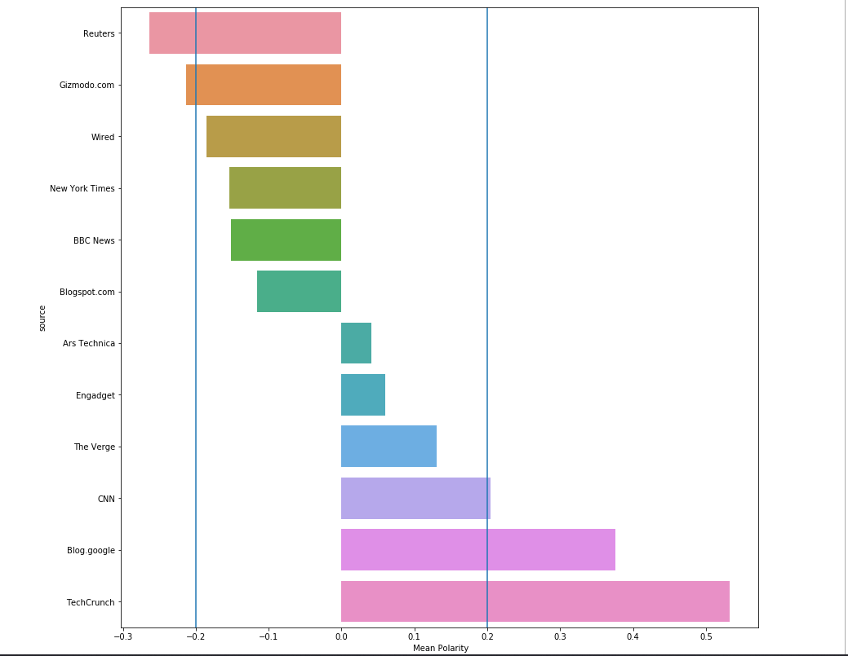
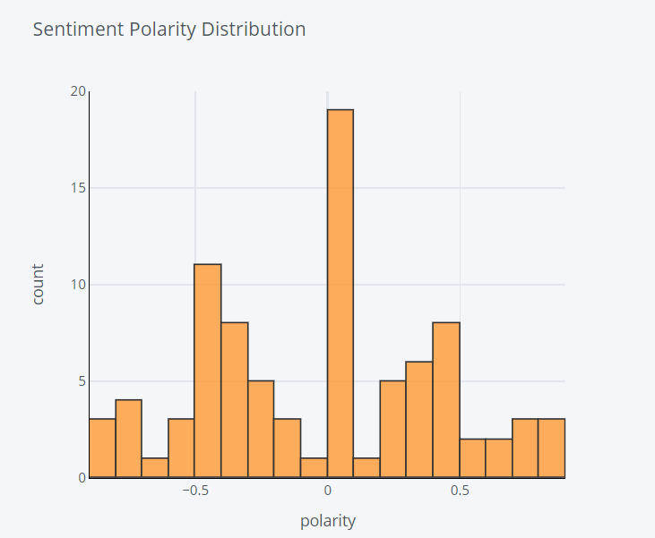
News segment sentiments

Slide 5
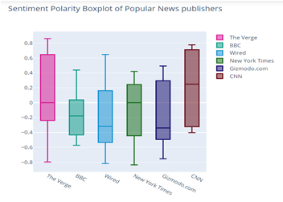
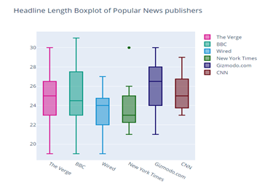
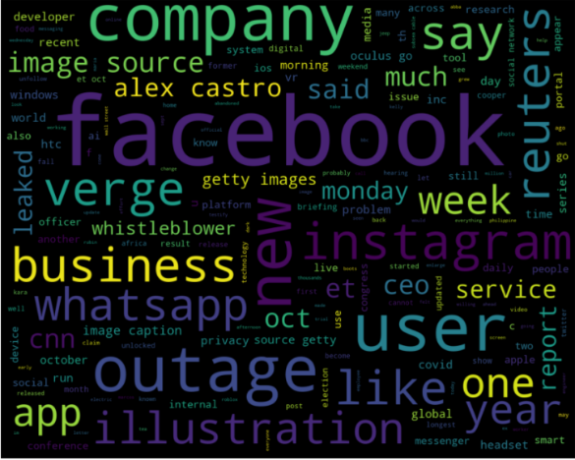
News segment sentiments

Slide 6
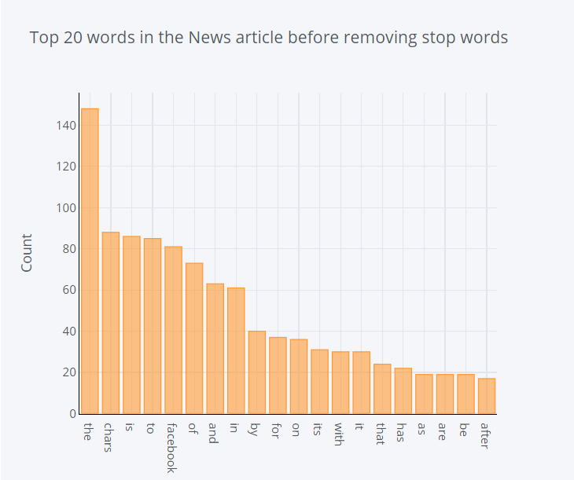
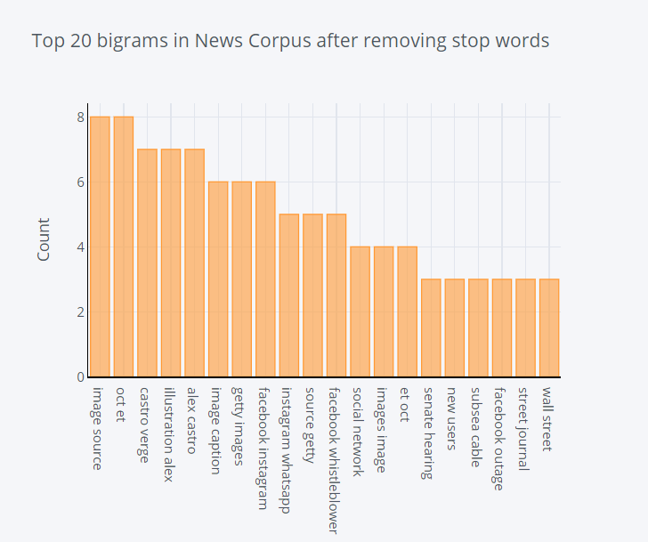
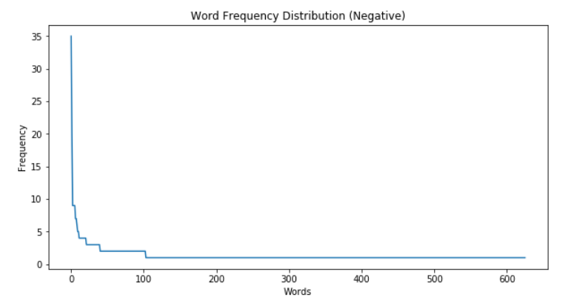
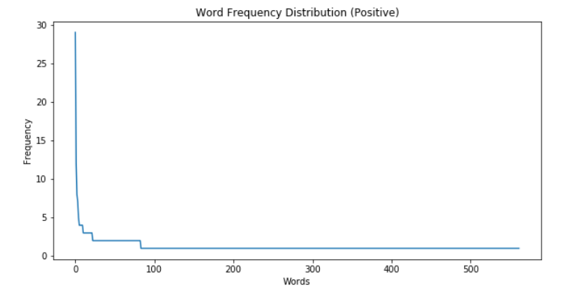
News segment sentiments

Slide 7
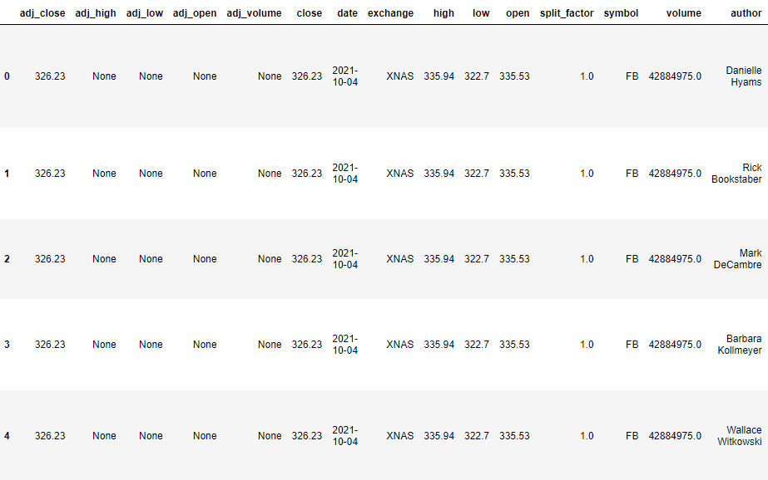
Stock market segment

Slide 8
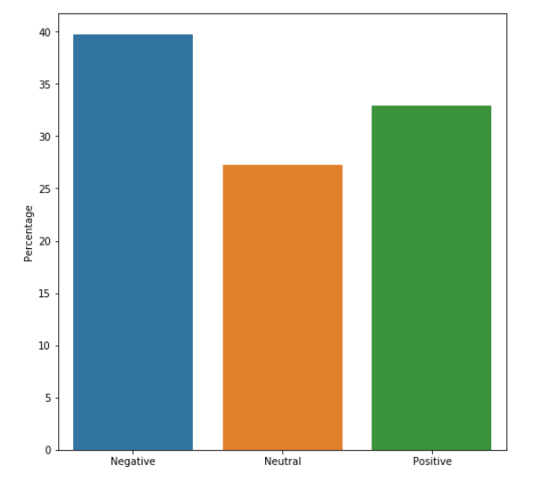
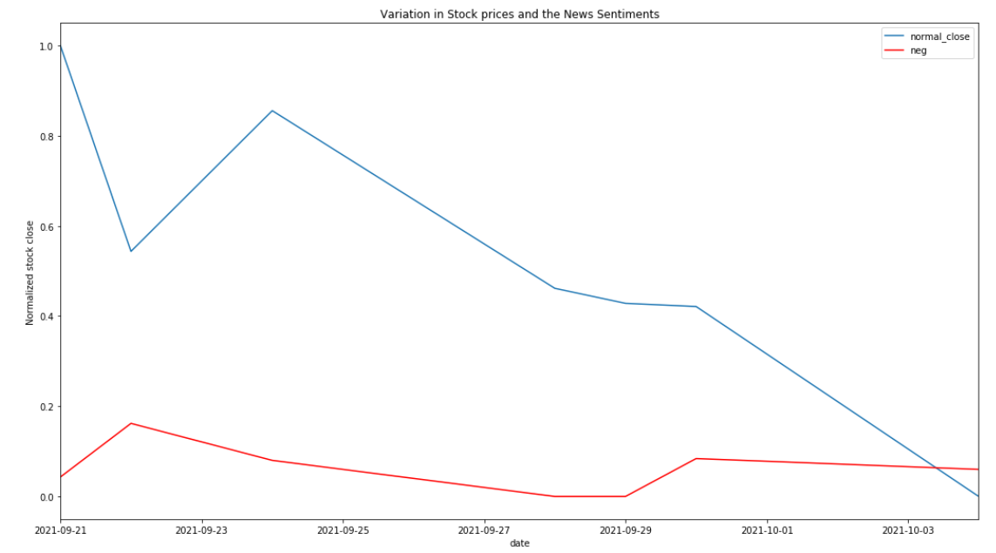
Stock market segment

Slide 9
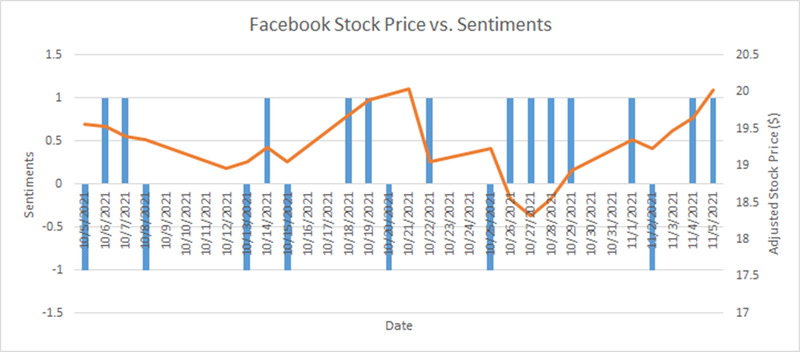
Stock market segment

Slide 10


Challenges
2
+
2
+
2
+

Slide 11
Challenges and changes
Limited API data
We became creative and searched for relevant keywords/ phrases
Obtaining data from relevant resources
Non-functional GitHub resources
Debugging, installing libraries, learning about nltk
Learning about sentiment analysis
word frequency distribution and Zipf’s law
word cloud
bigram analysis

Slide 12
THANK YOU
2
+
2
+

